Slide 1
SINGLETON Pattern
Singleton pattern is one of the simplest design patterns [creational pattern]. This pattern ensures that a class has only one instance and provides a global point of access to it.
The Singleton pattern simply uses a private constructor and a static readonlyinstance variable. Thread safety is guaranteed by the compiler.

Slide 2
Service/Server
Same Instance
Client 1
Client 2

Slide 3


Slide 4
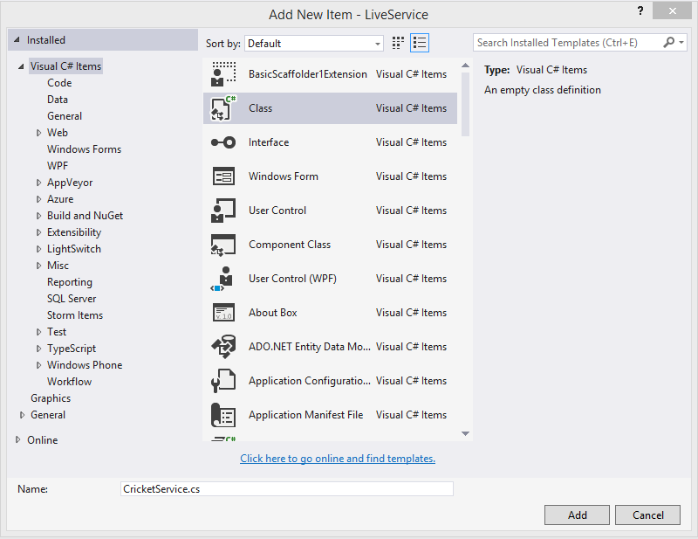

Slide 5
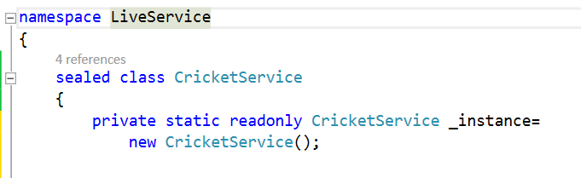
Sealed class with static readonly instance variable

Slide 6



Slide 7



Slide 8


Slide 9
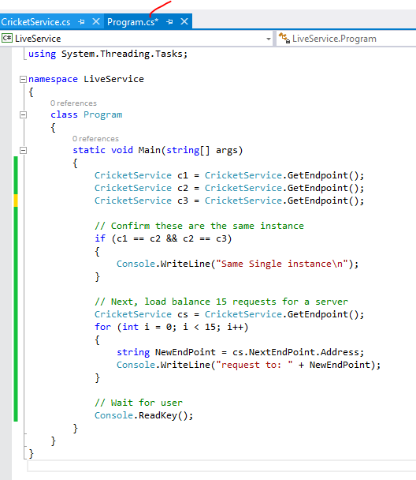

Slide 10


Slide 11
Where can we use this pattern ?

